Slide 1
Lewisburg Water & Wastewater Infrastructure Investment Plan
2027-2031 Capital Improvement Program
Ensuring Reliable Service, Regulatory Compliance, and Future Growth

Slide 2
Why We're Here
The City of Lewisburg Water Plant operating at or near maximum capacity of approximately 4 MGD
New State-approved permit allows 6 MGD
The City of Lewisburg and Cornersville are currently under a building moratorium due to water shortages
Cornersville WWTP operating at capacity
Cornersville currently under a sewer moratorium
Large capital investments needed in next 3-5 years

Slide 3
A System Built Generations Ago
Water Treatment Plant originally constructed in the 1940s
Wastewater Treatment Plant originally constructed in the 1950s
Infrastructure has served the community for more than 70 years
Past leaders invested for our generation
Now it is our responsibility to invest for the next generation

Slide 4
The Cost of Doing Nothing
Continued building moratorium in The City of Lewisburg and Cornersville
Continued sewer moratorium in Cornersville
Lost residential, commercial and industrial growth
Increasing maintenance costs
Greater risk of emergency failures
Delaying projects increases future costs

Slide 5
Project #1: New Water Treatment Plant ($26M)
Current production capacity limited to 4 MGD
Approved for 6 MGD permit
Origins of facility date to the 1940s
Removes major barrier to growth
Supports residential, commercial and industrial development
No water capacity means no growth

Slide 6
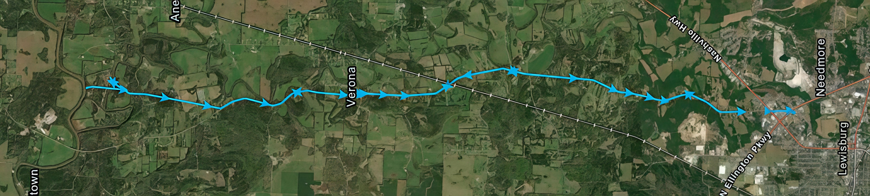
Duck River Intake and Raw Water Transmission Main
Duck River Intake Renovation Project
8.5 mile raw water main
Lewisburg Water Plant

Slide 7
Project #2: River Intake & Transmission Main ($8M)
Upgrade river intake system
Replace/rehabilitate raw water transmission line
Critical connection between source water and treatment plant
Improves reliability and reduces risk
Supports future treatment plant expansion

Slide 8
Project #3: Cornersville Force Main ($7M)
Cornersville WWTP at maximum capacity
Current sewer moratorium limits growth
Install approximately 9 miles of force main
Transfer flows to Lewisburg treatment system
Regional solution supporting future development

Slide 9
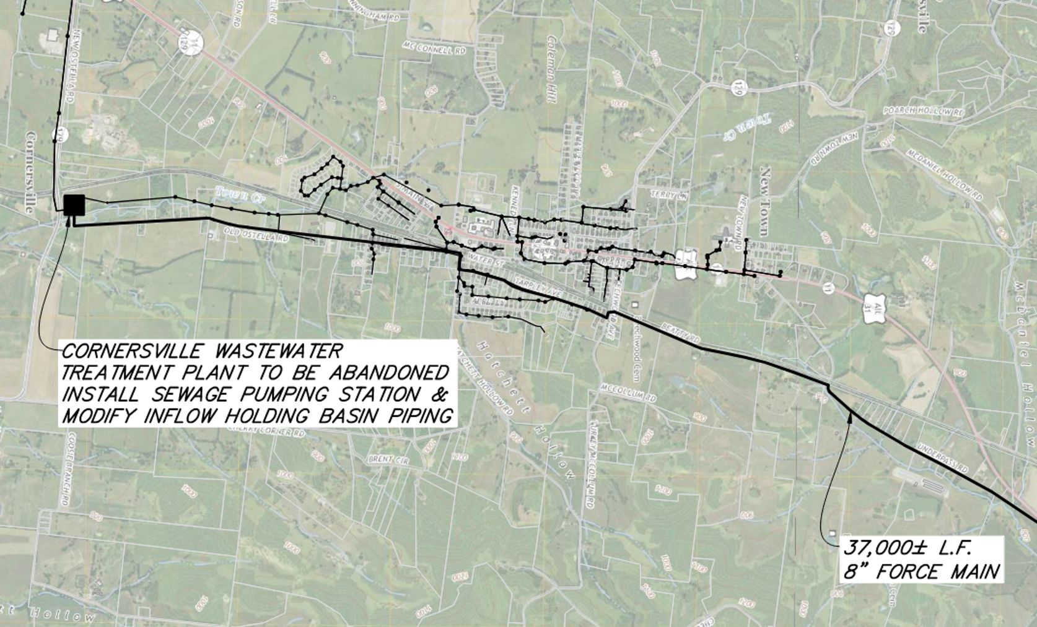
South Half of Route

Slide 10
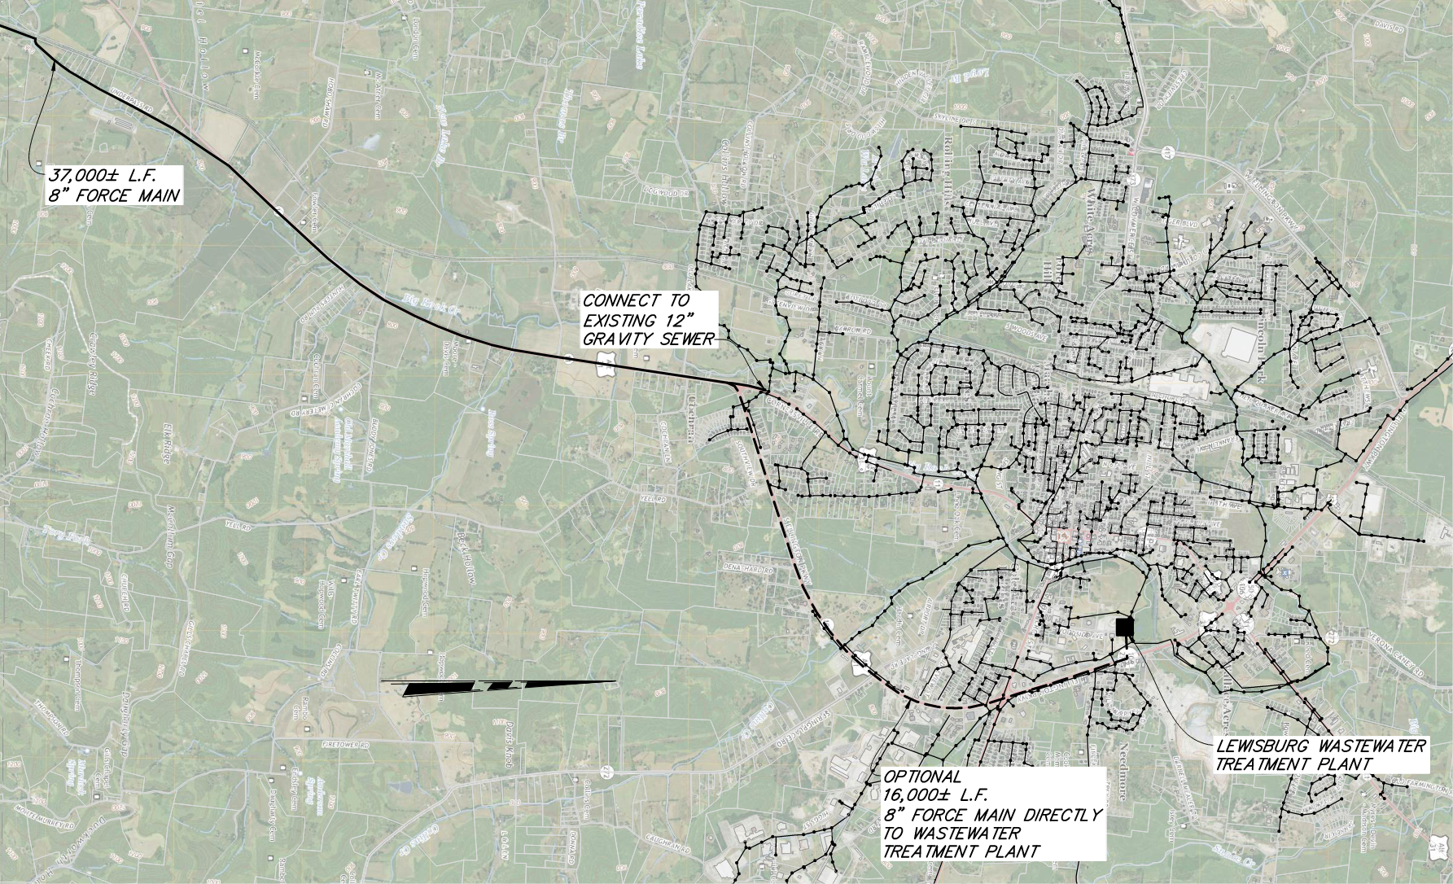
North Half of Route

Slide 11
Financial Reality
Water Treatment Plant: $26-28M
Intake & Transmission Main: $8-9M
Cornersville Force Main: $7-8M
Total Program: Approximately $40-45M
Funding: Bonds, SRF Loans, Grants, Utility Revenue

Slide 12
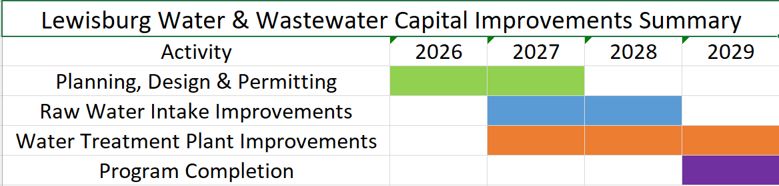
Proposed Plant & Intake Project Timeline (2026-2029)

Slide 13
Next Steps
Complete utility rate study
Finalize Engineering
Obtain TDEC approvals and permits
Prepare bid documents and procure construction pricing
Identify grant and SRF funding opportunities
Develop financing recommendations
Formally present funding, rate study recommendations and bond requirements to the City Council
Position Lewisburg and Cornersville for the next 50 years

Slide 14
Questions & Discussion
Thank you for your time, your support, and your commitment to our community.
At this time, I'd be happy to answer any questions, and if questions arise later, please feel free to contact me at Jake@LewisburgWater.org.
Jake Marquardt
Staff Engineer
Lewisburg Water & Wastewater
Jake@LewisburgWater.org

